Slide 1
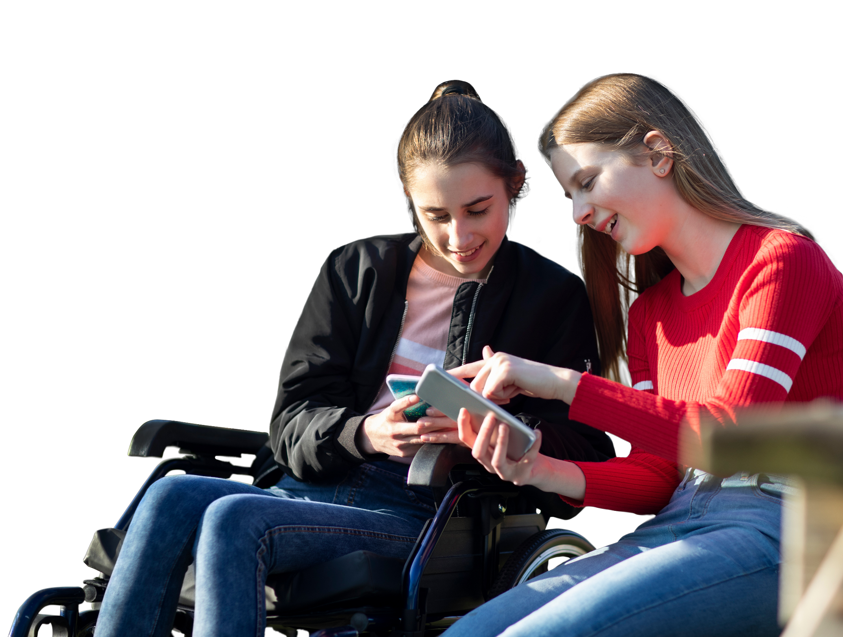
What to do

Slide 2
Overview
In this lesson, pupils learn how to identify worry and
actions that a person can take if they feel worried.
Recommended age group
Education providers for ages 10-11 (Year 6)
Time
45 minutes approximately
Preparation
Before delivering the lesson:
consider cross-curricular links and how this could be
related to other subjects
watch the film on slide 11 of this PowerPoint
read through classroom tips on slide 3
This lesson has been designed to be part of the planned programme for PSHE education and should be taught within the context of other PSHE education lessons.
It supports the Mental wellbeing strand of the Relationships Education and Health Education statutory guidance. See Curriculum Links for further information.
Resources
Blank A4 paper and pens
Relaxation activities PDF (optional)
Key vocabulary
Worry, nervous, emotions (feelings), relax (calm), resilience (keeping on when its hard), support (help), communication (talking/listening)
Follow up
You may wish to extend pupils’ learning with one of the extended learning projects on slide 24.

Slide 3
Classroom tips
Climate for learning
Read through Guidance for Learning in a Safe Environment.
This includes advice on:
developing and revisiting effective ground rules
drawn up with pupils
familiarity with your school’s safeguarding policy and procedures, including Child Protection and other relevant policies
being prepared in case pupils make a disclosure
including and protecting vulnerable pupils
using distancing techniques so that pupils can
discuss sensitive issues without being encouraged
to make a disclosure
handling sensitive questions
involving pupils with special educational needs
and disabilities (SEND) and autism
You may also wish to familiarise yourself with any schemes or offers available in your school, organisation or local area to support young people’s mental health. Your local public health team or school nurse should be able to help signpost you to this.
Anonymous question box
Place a question box or envelope somewhere in the classroom.
Pupils write down any questions that occur to them during the
lesson and submit them anonymously. You can address these questions in the next lesson.

Slide 4
Social distancing
Preparation
Returning to school and managing the changes that have come about in their lives because of Covid-19 will have posed many different challenges for young people. Every young person will have been affected differently and it will be more important than ever before for pupils to have a safe space to explore their feelings and experiences.
Reassure pupils that it's normal to worry about the impact of Covid-19 and that everyone will have had different responses. For example, some may have experienced loneliness, while others may have enjoyed lockdown – for many, there will have been a mixture of different emotions.
This lesson has a scenario related to Covid-19 and this may be particularly sensitive for any pupils who have experienced significant distress, loss or trauma prior to Covid-19 or during this time. There is clear guidance for teaching sensitive issues in the Guidance for Learning in a Safe Environment document and it is important that this is read before delivering this lesson.
Adapting lessons to social distancing;
Please refer to the Government guidelines
and your own school’s advice
Where pair or small group discussions aren’t possible, replace with personal reflections or individual contributions to whole class discussions
All scrunched-up/Un-scrunch me (slides 8 and 14)
Pupils could each have their own drawing of a pupil that they
scrunch up/un-scrunch as ideas are discussed as a whole class.
Alternatively a piece of flipchart paper could be used and the activity
carried out as a whole class with pupils instructing the teacher or
one of the pupils could add ideas and carry out the scrunching and un-scrunching.
A third option is that pupils make a ‘pupil’ out of pipe-cleaners
which they can scrunch and un-scrunch at the relevant points.

Slide 5
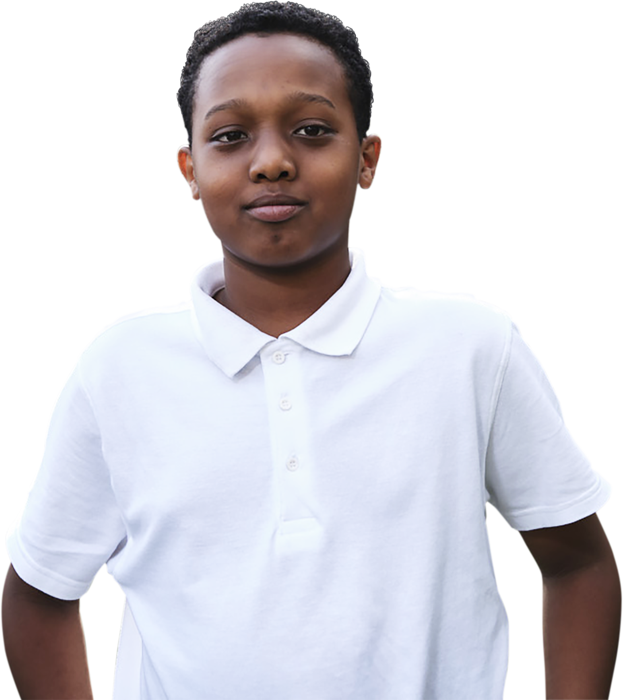
What are we learning?
Key vocabulary
worry
nervous
emotions (feelings)
relax (calm)
resilience (keeping on
when it’s hard)
support (help)
communication (talking/listening)
Learning objectives
recognise what worry might
feel or look like
describe actions a young person can take if they are worried
decide which actions might be more or less effective in dealing with worry
Learning outcomes
We are learning how to recognise worry and actions that a young person can take if they feel worried.
Notes:
Briefly share the learning objectives, outcomes and key vocabulary with pupils. Note that easier-to-understand alternative words are provided in the brackets.
Note that this slide features animated content and should be viewed in presentation mode.

Slide 6
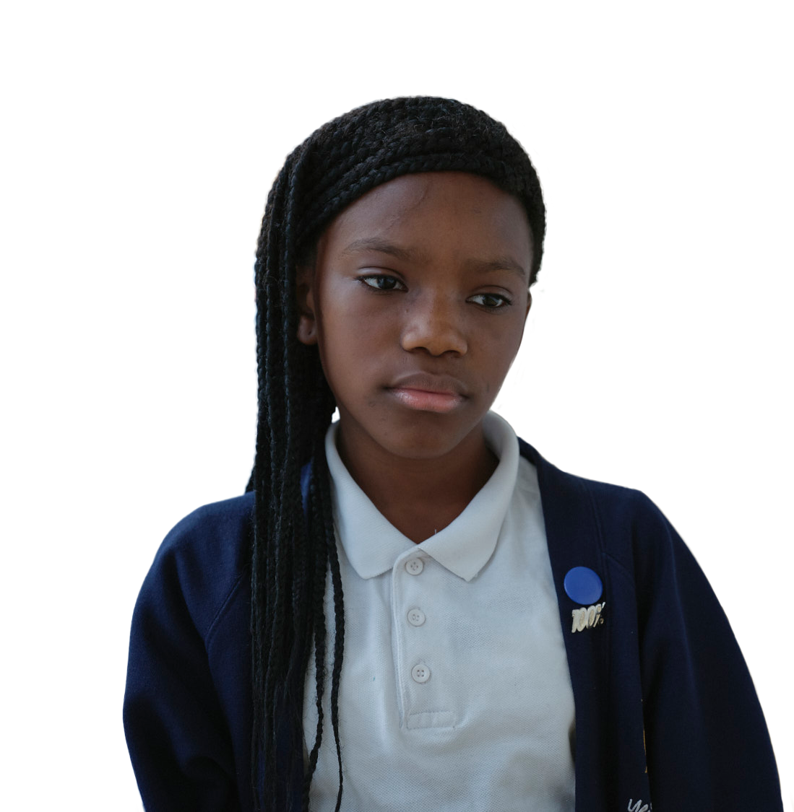
Scenarios
Scenario 1
It is the night before Sean’s birthday. He is going to
the park with his two best
friends to celebrate!
What is similar about how these young people could be feeling?
Scenario 2
Later today, Zara is playing
in a national wheelchair basketball competition.
Zara’s coach says that she
and her team should win
the competition.
What is different about how these young people could be feeling?
Notes:
Lesson stimulus (3-4 mins)
When discussing answers with the class, emphasize that both of these scenarios could cause positive emotions (like excitement) about seeing a friend or negative emotions (like worry) about social distancing at the park.
Explore the difference between excitement and nerves/worry; reassure them that sometimes feeling nervous, worried or stressed is perfectly normal and this lesson will help them know how to spot the signs of worry, learn some skills they can use and know when to seek support.

Slide 7
How confident are you in…
10
Extremely confident
9
8
7
6
recognising worry? Including
what it looks and feels like
describing actions that a young person can take if they are worried?
deciding which actions might
be more or less effective in dealing with worry?
5
4
3
2
1
0
Not confident
Notes:
Baseline assessment : How do you feel? (3-4 mins)
Show pupils the statements and ask them to rate their confidence in each using a scale from 0-10 (0 = not confident, 10 = extremely confident). There are lots of ways you might do this activity. Pupils could respond to the statements individually by writing their three numbers down on paper, or verbally by discussing their feelings in pairs/groups. Alternatively, you could ask pupils to reflect silently, before holding up the relevant number of fingers in response to each statement.
How confident are you in:
recognising worry? Including what it looks and feels like
describing actions that a person can take if they are worried?
deciding which actions might be more of less effective in dealing with worry?
You may wish to explain to pupils that in identifying what worry looks a feels like, they will also be thinking about how it is different from excitement – as touched upon on slide 6.

Slide 8
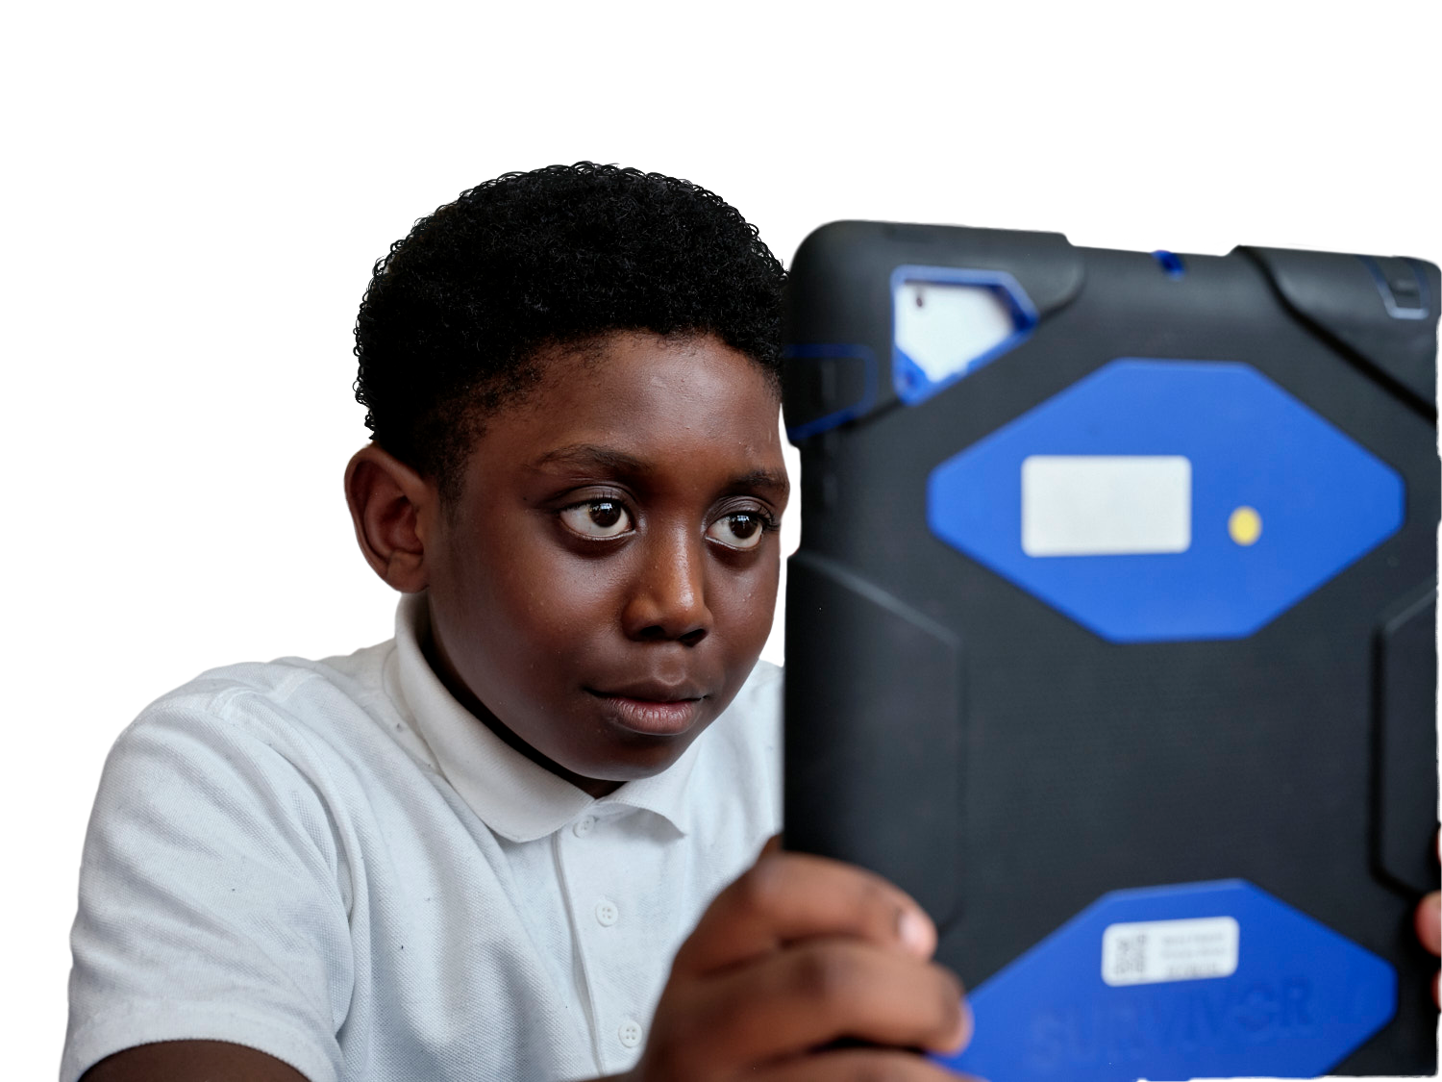
All scrunched-up
In your groups draw an image of a pupil who has just started the new school year.
What worries might this new pupil have
about the school year ahead?
Notes:
Activity 1: All scrunched-up (15 mins)
Explain to pupils that you are going to be doing an activity called ‘All scrunched-up’ because sometimes, when a young person is nervous or worried, they might feel physical sensations, a bit like being ‘scrunched-up’ inside.
Arrange pupils in small groups (groups of four work best) and give them an A4 piece of scrap paper. On their paper, pupils should draw a stick figure and imagine that this is a Year 6 pupil who has just moved up from Year 5 (or a pupil who is new to Year 7 if you are closer to the end of the school year). Pupils may want to give their stick figure a name and list three things they like doing.
Ask pupils to pass their figure around the group and as they pass it, say one thing that the pupil might be nervous or worried about in the school year ahead, e.g. having moved to a new area or school, performing in a school play, doing a presentation in class. Each time pupils pass the figure on, they can scrunch it up a little bit (being careful not to tear it). Keep passing it on and giving examples until it is a tightly scrunched-up ball. Note, if teaching this lesson under social distancing measures, see Alternative options for social distancing below.
Take some ideas from each group and write these up on the board. Once the examples have been shared on the board, allocate one to each group to focus on (activity explained on following slide).
Note: If worries related to Covid-19 come up, encourage pupils to focus on what general worries related to the school year and learning a pupil might have to allow them to explore their feelings and experiences in a distanced way without becoming overwhelmed. Encourage pupils to think about this question in a distanced way and not to use any personal examples. Note that pupils may have experienced bereavement, time apart from family members, caring responsibilities or domestic violence.
Alternative options for social distancing:
Pupils could each have their own drawing of a pupil that they scrunch up/un-scrunch as ideas are discussed as a whole class.
Alternatively a piece of flipchart paper could be used and the activity carried out as a whole class with pupils instructing the teacher or one of the pupils could add the ideas and carry out the scrunching and un-scrunching.
A third option is that each pupil makes a ‘pupil’ out of pipe-cleaners which they can scrunch and un-scrunch at the relevant points.

Slide 9
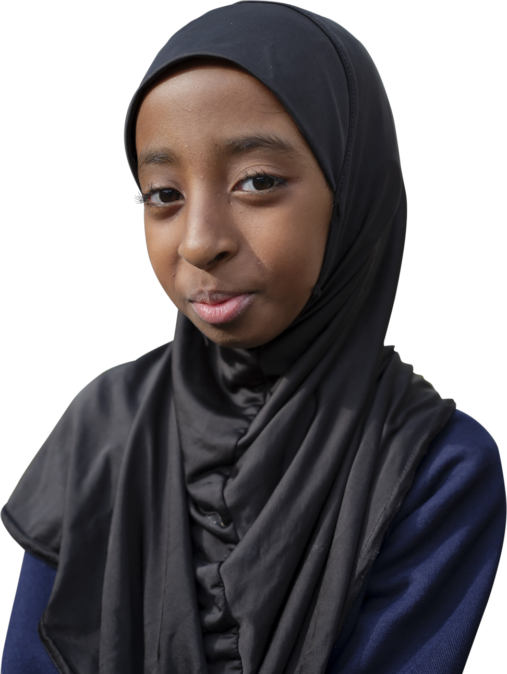
What are the signs of worry?
Feelings:
Physical signs:
What feelings might the
Year 6 pupil have?
Think about positive and negative feelings that might be linked.
Where might the Year 6 pupil
feel the worry in their body?
What physical signs of worry
might be seen?
Thoughts:
Actions (or behaviours):
What might the Year 6
pupil be thinking?
How might the Year 6 pupil
behave or act as a result of
these thoughts, feelings and physical signs?
Notes:
Explain to pupils that they are going to be considering the different ways in which a person can recognise worry. Ask them to place their scrunched-up ball in the middle of a big piece of paper and write four headings; ‘Thoughts’, ‘Feelings’, ‘Physical signs’, ‘Actions (or behaviours)’ around the side of their paper.
Using their allocated example of a worry, ask pupils to make a list of the different signs of worry/nerves under each heading. You can click to reveal the different prompt questions below:
Feelings: What feelings might the Year 6 pupil have? Think about positive and negative feelings that might be linked. For example, excited, scared, hopeful, nervous, frozen, angry, restless, numb or empty
Thoughts: What might the Year 6 pupil be thinking? For example, will the work be harder or different to how it was in Year 5? Will they still have the same friends? What will the new teacher be like? Perhaps, they’re excited and can’t wait to get started! Or perhaps they’re thinking ‘What if…?’
Physical signs: Where might the Year 6 pupil feel the worry in their body? What physical signs of worry might be seen? For example, worry might be felt in the Year 6 pupil’s stomach or tummy, chest, head or throat. Physical signs of worry might include a faster heartbeat, dry mouth, sweaty palms, fidgeting, difficulty concentrating, feeling sick or wanting to go to the toilet. Physical signs like a tummy ache or head ache can be especially common if the Year 6 pupil is worrying over a long period of time.
Actions (or behaviours): How might the Year 6 pupil behave or act as a result of these thoughts, feelings and physical signs? For example, they might be especially quiet – or especially loud. They might seem distant or distracted, become ill or want to go home. They might avoid situations or people that worry them or seek lots of reassurance from those around them.

Slide 10
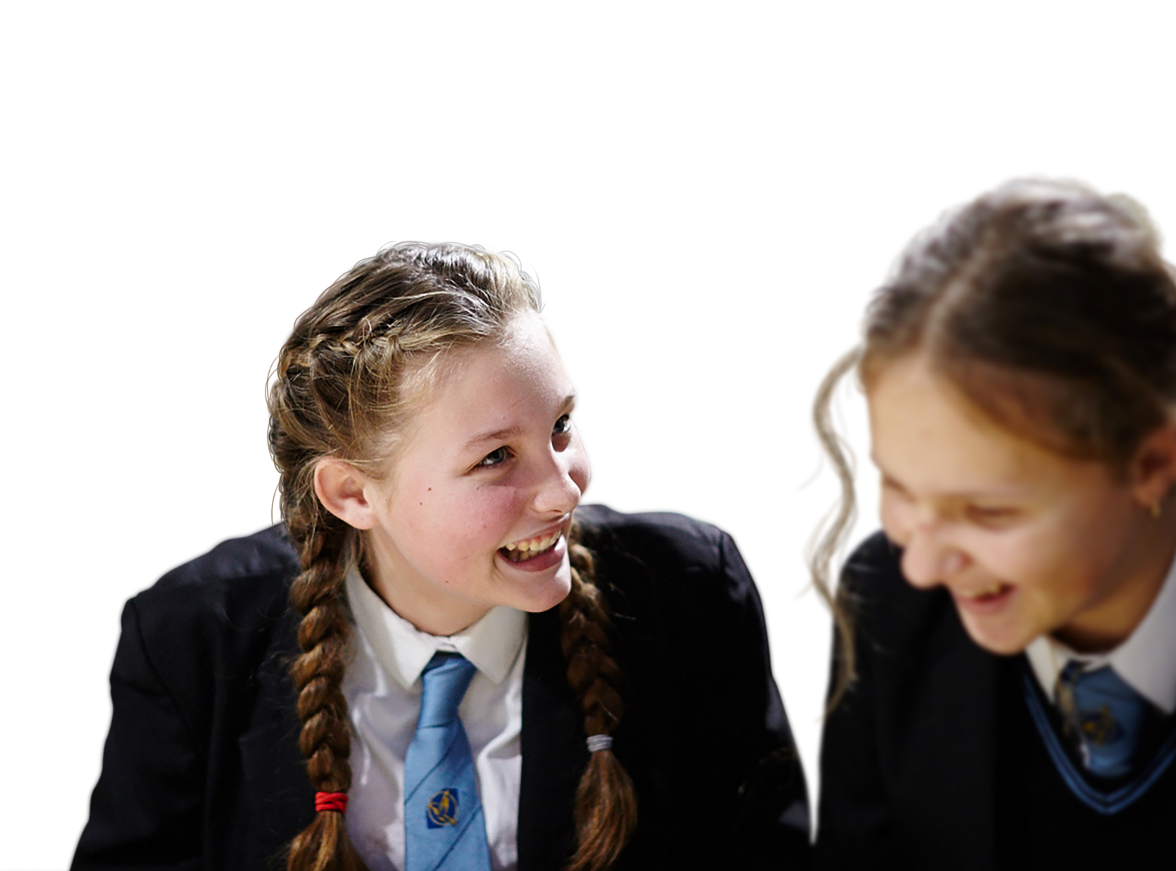

Discussion questions
Which of the four areas might be the strongest sign of worry and why?
Why can it sometimes be difficult to
tell if people are worried/nervous?
Is worry different from excitement? How?
Challenge
Do you think worries
can ever be helpful?
Explain your thinking.
Notes:
Show pupils the discussion questions and give them a few moments of thinking time.
All :
Which of the four areas might be the strongest sign of worry and why? This may depend from person to person but often worry can show up strongly in physical signs. A person might try to pretend they are not worried but sometimes their bodies and their actions let them know. Thinking a lot about something you are concerned about over and over again is also a key sign of worry.
Why can it sometimes be difficult to tell if people are worried/nervous? Sometimes people get worried about telling someone they are worried! This can be because they don’t think they should be worried, they feel shy, they don’t want anyone to worry about them or they don’t want to get themselves or someone else into trouble. Reassure pupils that everyone feels worried at times, it’s a very normal feeling and it is always good to talk to someone you trust if you feel worried.
Is worry different from excitement? How?
Further challenge :
Do you think worries can ever be helpful? Explain your thinking. This question can help pupils think about the fact that worries can have a purpose – sometimes, if we can do something about a worry, then the worry will encourage us to act and that can be a good thing. Emphasize that while worry can have a purpose, ‘worrying’ is different. Worrying is a pattern of repeatedly thinking/fretting over things. Worrying continuously about something can create physical symptoms, like aches or pains, a ‘racing heart or feeling hot and bothered. It can also result in behaviours like avoiding situations or angry outbursts.

Slide 11
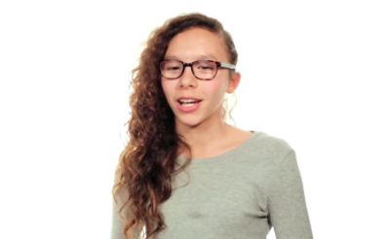

Un-scrunch me
What actions could help the pupil
to un-scrunch and find a way to deal with their worries? Come up with a list of ideas.
Can you add any new ideas from
this video?
Private reflection
During Covid-19, what helped you
relax or feel good?
Do you think the same thing could help another pupil who was feeling worried?
Notes:
Activity 2: Un-scrunch me! (20 mins)
Tell pupils that in their groups, they are going to see if they can help the Year 6 pupil to un-scrunch and find a way to deal with their worries. But first they need to come up with ideas that might help! In their groups, can they think of any actions that could help the Year 6 pupil to ‘un-scrunch’ or feel less worried? Each group should note down their ideas on a large piece of paper.
Tell pupils that for extra ideas, they will be watching a short video. Share the video on this slide and advise pupils to look out for any further actions that could help the Year 6 pupil to deal with their worries.
Note, if you have any issues playing the video from the PowerPoint, if you are connected to the internet then you can return to the What to do about Worry resource page and play the video from there: https://campaignresources.phe.gov.uk/schools/resources/what-to-do-about-worry-year6-lesson-plan-pack
As a class, ask pupils to list any ideas mentioned in the video. They should continue to add these ideas to their piece of paper. If pupils need further ideas, share the ideas bank on the next slide.
Invite pupils who feel comfortable to complete the private reflection: ‘During Covid-19, what helped you relax or feel good? Do you think the same thing could help another pupil who was feeling worried?’ If they wish they could add any strategies they found helpful to the list, but this is entirely optional.

Slide 12
The worry tree
Notice the worry
What are they worrying about?
Can you help the Year 6
pupil to work their way
through the worry tree?
Can they do something about it?
No
Yes
Try to let the worry go
Make a plan!
What? How? When?
“I’m worried about making new friends.”
“I’m worried that
my friend, Nathan,
is angry with me.”
Now?
Later?
Do it!
Decide when
Try to let the worry go
Notes:
The worry tree
The worry tree can be a useful tool to work through worries. This slide and the next offer example worries – click to reveal the different stages within the worry tree and encourage pupils to work through the worry tree to help the Year 6 pupil.
When you reach the question ‘Can the pupil do something about it?’ explain that with this worry, the pupil can do something, so the next step is to look at possible solutions and make a plan.
Note that pupils should not be encouraged to share their own personal worries in the classroom. The worry tree is available as a print-out PDF and can be given to pupils as a home learning task or used as a classroom display, although again pupils should not be encouraged to publicise their worries or add them to the class display. Instead, it can serve as a visual reminder of the strategy.
More worry tree scenarios can be found at the end of this PPT.
Explain to pupils that it can be helpful to write worries down and put them in a worry box or jar that keeps the worries for you so you can let them go. Pupils could also try having 'worry time' where they keep any worries they have for a specific part of the day or week, with the rest of their time being worry free.

Slide 13

Ideas bank
Some other ideas if you get stuck:
Writing worries down
Speaking to someone trusted about worries
Doing something about it (if possible!)
Being active
Learning something new
Doing a favourite hobby
Creating (for example, doing a piece
of art, crafts or making a drama)
13
Notes:
If pupils need further ideas, share this ideas list
Writing worries down – some people find this can get worries out of their head and onto paper. This could be done with a diary, with worry dolls, or with a worry box if you have one in the classroom
Speaking to someone trusted about worries – sometimes, by just speaking about worries, it can make them feel less scary and sometimes other people can help with the things you are worried about
Doing something about it (if possible!) – for example, if the worry is about forgetting homework, then an action could be to write a reminder
Being active (for example, dancing, playing an energetic game or running in the playground). Again, this can help to shift the focus from thoughts and feelings
Learning something new – for example, getting lost in a book, learning a new skill (like juggling!) or starting a new club at school
Doing a favourite hobby
Creating – for example, doing a piece of art, making a model or doing some drama)

Slide 14

Un-scrunch me
Pass the scrunched-up ball around. On your turn pick an action you think will help with worries and un-scrunch the ball before passing it on. Keep going until the ball is completely un-scrunched.
Notes:
Once more, pupils can pass the scrunched-up ball, representing the Year 6 pupil, around their group. When a pupil gets the ball, they should pick an action from their piece of paper and read it out loud. As they do this they can un-scrunch the ball a little.
Pupils can keep going until they have completely un-scrunched their person and read out all of their ideas. Note, if teaching this lesson under social distancing measures, see Alternative options for social distancing below.
Support: Model an example for any pupils who may need support e.g. writing worries down might help a little bit (un-scrunch the ball a little), talking to friends about how you feel might help a lot (un-scrunch the ball a lot)
Optional challenge: Say whether the action you have chosen would be very, quite or a little helpful at dealing with worry and then un-scrunch the ball either a lot, a bit or a little. Try to explain why.
Alternative options for social distancing:
Pupils could each have their own drawing of a pupil that they scrunch up/un-scrunch as ideas are discussed as a whole class.
Alternatively a piece of flipchart paper could be used and the activity carried out as a whole class with pupils instructing the teacher or one of the pupils could add the ideas and carry out the scrunching and un-scrunching.
A third option is that each pupil makes a ‘pupil’ out of pipe-cleaners which they can scrunch and un-scrunch at the relevant points.

Slide 15
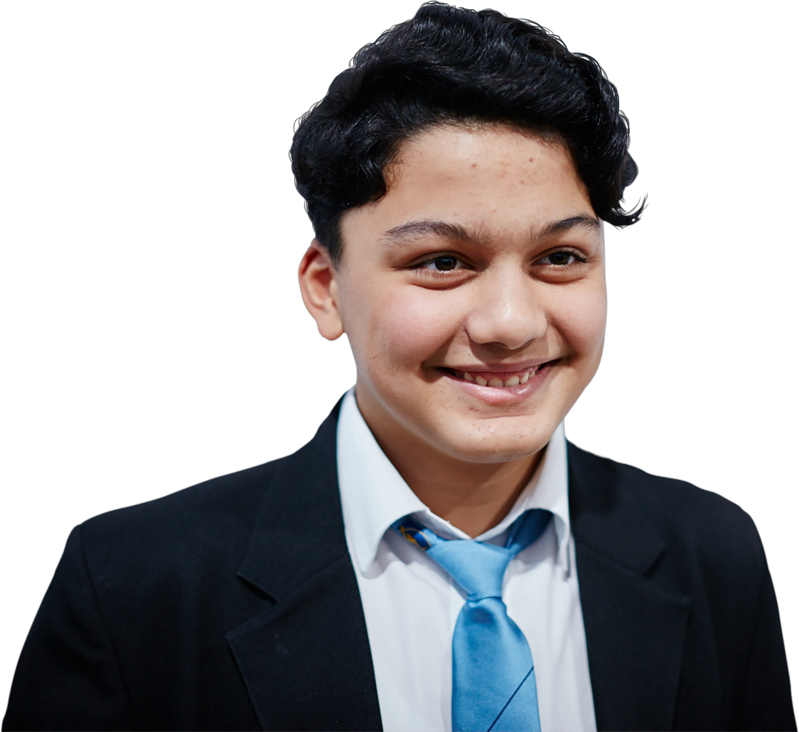
Discussion questions
How might the Year 6 pupil feel
now they are un-scrunched?
Did you learn any new ideas a young person could use to deal
with worry?
Challenge
Which ideas were the most
helpful for un-scrunching and why?
Do you think the person would have
been able to un-scrunch on their own? Explain your answer.
Notes:
Show pupils the discussion questions and give them a few moments of thinking time.
All
How might the Year 6 feel now they are un-scrunched? For example, relieved, confident, happy and calm
Did you learn any new ideas a young person could use to deal with worry?
Further challenge
Which ideas were the most helpful for un-scrunching and why?
Do you think the person would have been able to un-scrunch on their own? Explain your answer.
Encourage pupils to explore both sides. Sometimes a person can have strategies to get rid of worry on their own and that can be really helpful. But there are also times when a person needs others to help them with their worries

Slide 16
How confident are you now in…
10
Extremely confident
9
8
7
6
recognising worry? Including
what it looks and feels like
describing actions that a young person can take if they are worried?
deciding which actions might
be more or less effective in dealing with worry?
5
4
3
2
1
0
Not confident
Notes:
Follow up assessment (3-4 mins)
Show pupils the statements A-C from the initial assessment and ask them to rate their confidence in each using a scale from 0-10 (0 = not confident, 10 = extremely confident) or whichever response method was used in the initial activity. It is an opportunity for pupils to reflect on what they have learned in the lesson. Ask pupils to consider why their scores have changed and give an example of something new they have learned or thought about.
How confident are you in:
recognising worry? Including what it looks and feels like
describing actions that a person can take if they are worried?
deciding which actions might be more of less effective in dealing with worry?

Slide 17
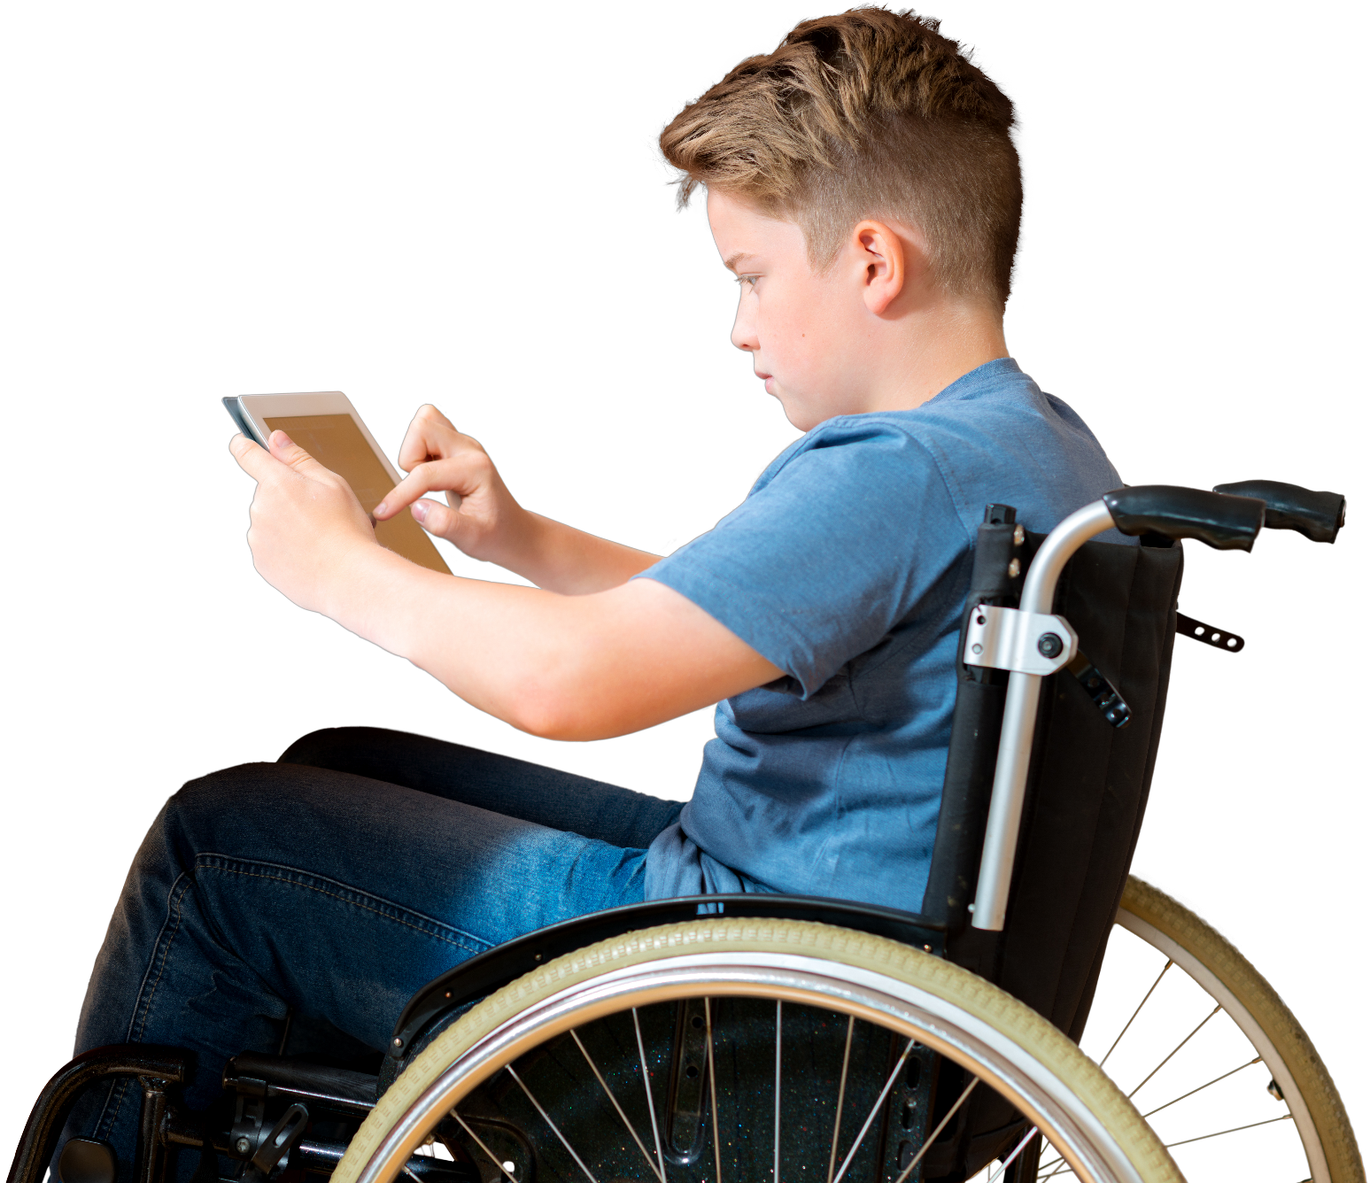
Everybody feels nervous or worried at times.
It is always good to try out the different actions you have learnt in the lesson but
if worries get too much, it is important that you speak to a trusted adult and get some more help.
Childline:
childline.org.uk/info-advice
Or call 0800 1111
Shout:
Text 85258
Notes:
Signposting
Share this slide with pupils and remind them that everybody feels worried or nervous at times. It is always good to try out the different actions they have learned in the lesson, but if worries get too much it is important that they speak to a trusted adult and get some more help.
If things become difficult, they should speak to a trusted adult in school, at home or contact Childline (0800 1111 or https://www.childline.org.uk/) or Shout. Childline runs free telephone helplines for children and young people, while Shout offers free text messaging support.

Slide 18
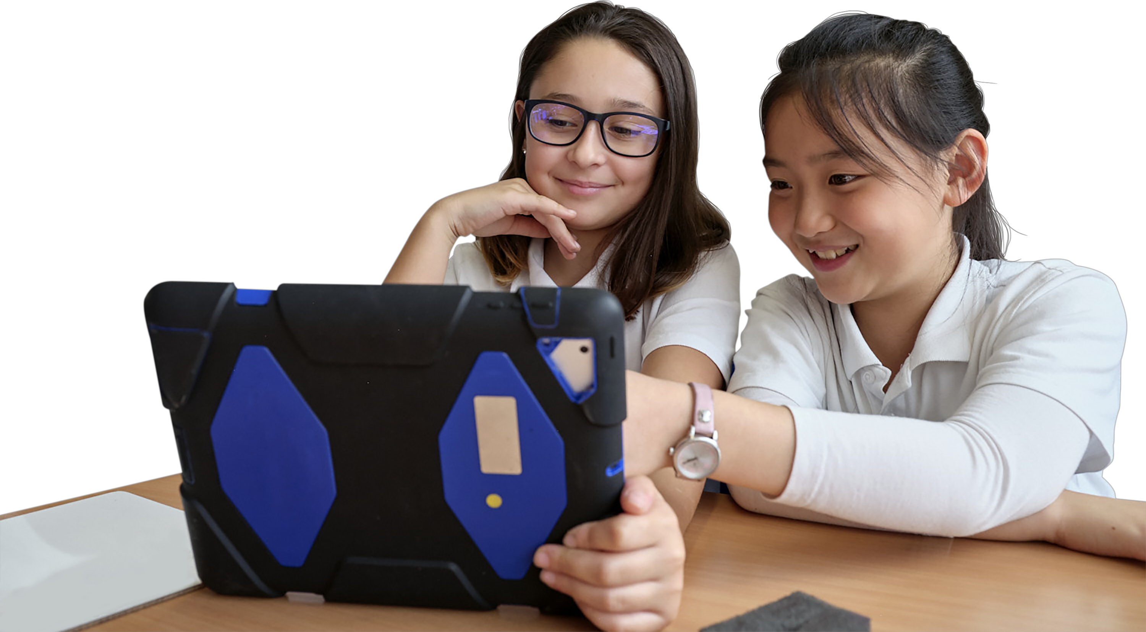
Additional
Additional
relaxation activities
relaxation activities
18
Notes:
These optional activities can be used with the class to further support them in dealing with worries.

Slide 19
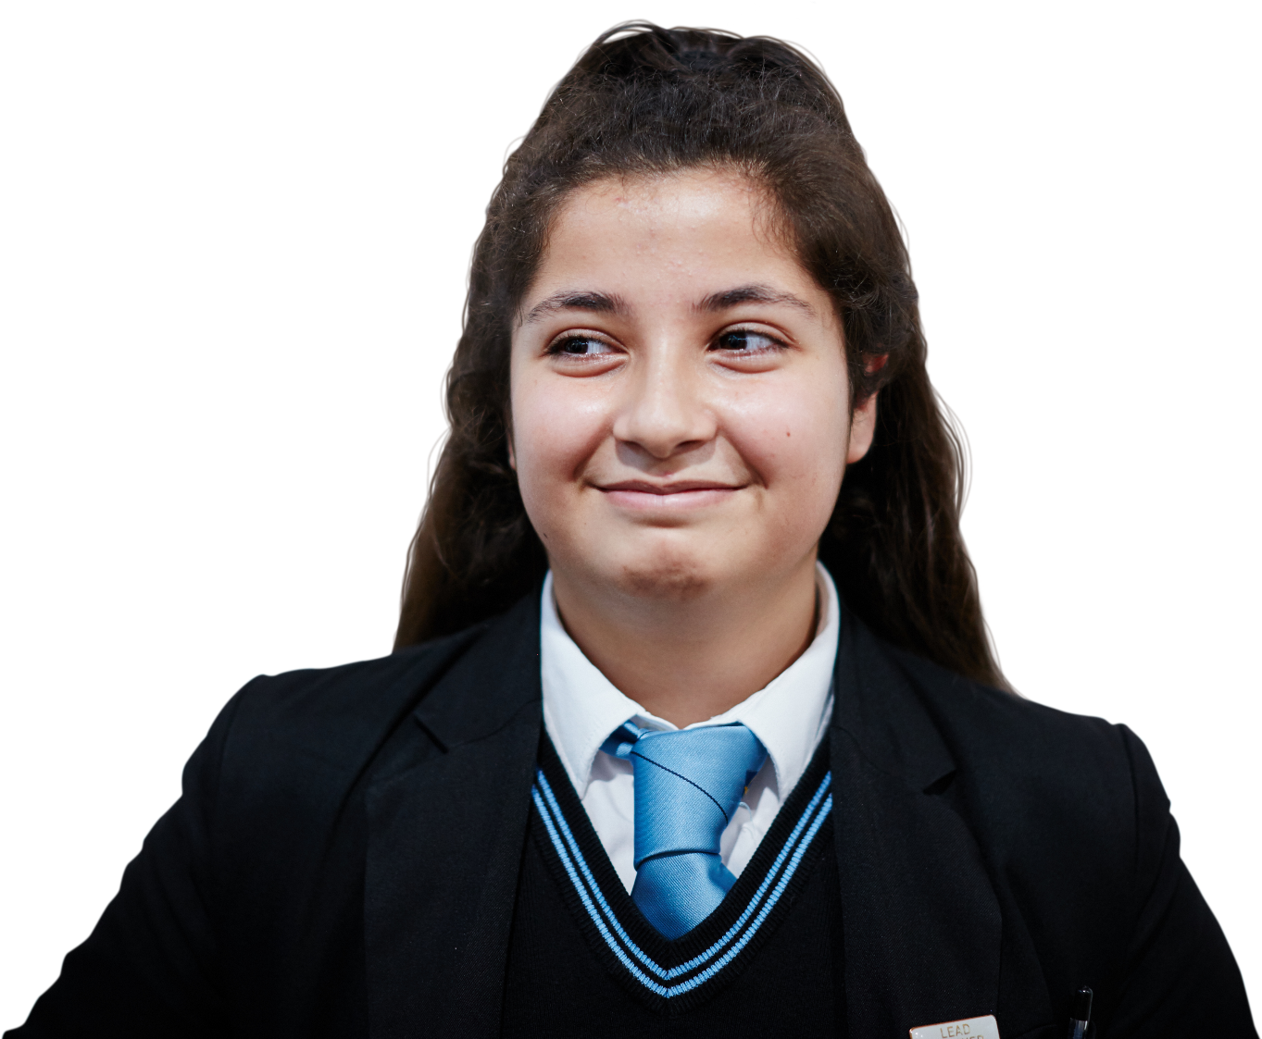
Advice station
Khairah found learning at home very
difficult during Covid-19. She is worried
that she won’t remember lots of things
now she’s back at school.
What advice would you
give to help the pupil
with their worry?
Lauren has trouble speaking up in front of
the class. She finds it hard to breathe and
always thinks she’s going to mess it up.
James’ cousin is moving house and
James is worried that the move will affect
their friendship. He thinks about it loads,
especially at night time.
Notes:
Advice station (Optional 5 mins)
Ask pupils to pick one scenario and decide what advice they would give to help that pupil with their worry.

Slide 20
The worry tree
Notice the worry
What are they worrying about?
Can you help the Year 6
pupil to work their way
through the worry tree?
Can they do something about it?
No
Yes
Try to let the worry go
Make a plan!
What? How? When?
“I’m worried that
my friend, Nathan,
is angry with me.”
“I’m worried that
my friend, Nathan,
is angry with me.”
Now?
Later?
Do it!
Decide when
Try to let the worry go
Notes:
The worry tree additional scenarios (Optional: 5-10 mins)
The worry tree can be a useful tool to work through worries. This slide and the next offer example worries – click to reveal the different stages within the worry tree and encourage pupils to work through the worry tree to help the Year 6 pupil.
When you reach the question ‘Can the pupil do something about it?’ explain that with this worry, the pupil can do something, so the next step is to make a plan.
Note that pupils should not be encouraged to share their own personal worries in the classroom. The worry tree is available as a print-out PDF and can be given to pupils as a home learning task or used as a classroom display, although again pupils should not be encouraged to publicise their worries or add them to the class display. Instead, it can serve as a visual reminder of the strategy.

Slide 21
The worry tree
Notice the worry
What are they worrying about?
Can you help the Year 6
pupil to work their way
through the worry tree?
Can they do something about it?
No
Yes
Try to let the worry go
Make a plan!
What? How? When?
“I’m worried about the
things I read in the news.”
“I’m worried about the
things I read in the news.”
Now?
Later?
Do it!
Decide when
Try to let the worry go
Notes:
This slide offers an example worry – click to reveal the different stages within the worry tree and encourage pupils to work through the worry tree to help the Year 6 pupil.
When you reach the question ‘Can the pupil do something about it?’ explain that with this worry, the pupil can’t do anything about the worry (although note they could look at the news less) so the next step is to try to let the worry go. This can be tricky! Even for adults. But there are different strategies that might help young people to refocus their attention and let a worry go. Two examples are given on the following slides.
Note that pupils should not be encouraged to share their own personal worries in the classroom. The worry tree is available as a print-out PDF and can be given to pupils as a home learning task or used as a classroom display, although again pupils should not be encouraged to publicise their worries or add them to the class display. Instead, it can serve as a visual reminder of the strategy. If you wish to work through the worry tree further, be sure to use the Year 6 pupil and examples of their worries to depersonalise the learning.

Slide 22

Relaxation station
Petal breathing
Look at your hand. Imagine it is a flower and your fingers are the petals. As you breathe in, close the petals so they touch and as you breathe out open the petals as wide as you can.
Repeat 20-30 times.
Notes:
Relaxation station (Optional - 5 mins)
Explain to pupils that there are things a person can do even when they are not feeling worried to help them be better able to deal with problems and worries when they happen. These strategies can also be used at the last step of the worry tree – to help with letting worries go.
It’s recommended to try these activities as a whole class initially, using the instructions below. You could then have pupils try out the different activities in pairs or small groups, reflecting on how they feel before and after and feeding back on their favourite.
Instructions for the activity
Ask pupils to look at the flower on the board. Tell pupils that they are going to imagine that their hand is that flower and the fingers are the petals
Model the activity and talk over what is taking place – showing your fingers closing into your palm as you breath in and opening and stretching our wide – like open petals – as you breathe out
Have a go as a whole class to make sure everyone understands the activity
Once you are confident everyone understands, have them do these actions for 20-30 breaths, in their own time
Note that these activities are also available as a print-out PDF. This activity should not be delivered to any pupils who have experienced or are experiencing psychosis.

Slide 23
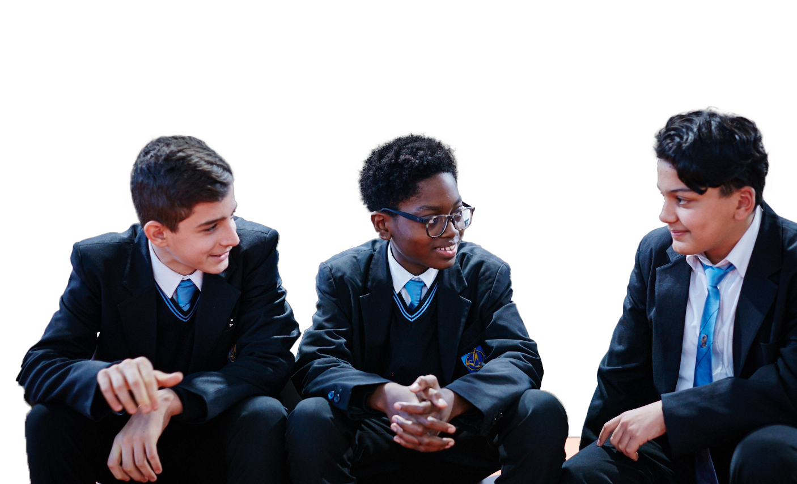
Relaxation station
Imagination
Use your imagination to create
a place of total relaxation!
You might want to use paper or pens or words to create a calm, relaxing place.
Notes:
Relaxation station (Optional - 5 mins)
Explain to pupils that there are things a person can do even when they are not feeling worried to help them be better able to deal with problems and worries when they happen. These strategies can also be used at the last step of the worry tree – to help with letting worries go.
It’s recommended to try these activities as a whole class initially, using the instructions below. You could then have pupils try out the different activities in pairs or small groups, reflecting on how they feel before and after and feeding back on their favourite.
Instructions for the activity
This is an example of visualisation and guided imagery techniques
Encourage pupils to think of a place or time where they feel at peace and relaxed (it can be real or imagined)
Encourage pupils to imagine all the different parts of that place or time – they could close their eyes while they do this and imagine themselves absorbing the different senses (what can they see? Hear? Smell? Feel? Touch?)
If time allows, pupils could draw their place of relaxation using paper or pens and this could be referred to in future
Note that these activities are also available as a print-out PDF.

Slide 24
Extended learning projects
Class un-scrunching!
Come up with a list of things that might make a Year 6 class feel ‘scrunched-up’. Then come up with relaxation images, positive words and actions or breathing activities that the whole class can do. Create a display and that can be used throughout the year.
Say it with words
Create a poem for someone to read to work through a time
when they are feeling uneasy.
Worry Tree
Complete the worry tree at home, as a personal reflection task. You could also use the worry tree to form a classroom display to remind pupils of this strategy for addressing worries. Note that pupils should not be encouraged to publicise their worries or add them to the class display. The worry tree is available as a print-out PDF.
Notes:
Extended learning projects
These can be given to pupils as projects to extend their learning, these could be done either in school or at home.

