Slide 1
Presented by [insert class name]

Slide 2
Notes:
Family Snack Challenge leaflets will be delivered with the School Fruit and Veg Scheme during January 2018.
The leaflets can also be downloaded here: https://campaignresources.phe.gov.uk/schools/resources/Family-snack-challenge-leaflet

Slide 5
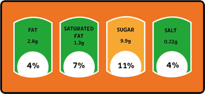
Notes:
1 cube = 4g sugar
You could present the key facts and top tips in various ways:
create a short role play scenario where one pupil learns about the key facts.
you could bring in a few packaged snacks with the colour coding on the label to demonstrate what to look for.
Remember that fresh fruit and vegetables, plain milks and plain natural yoghurts all contain ‘intrinsic sugars’, which we don’t need to worry about. 5 A Day guidance specifies that dried fruit and fruit juice, vegetable juice and smoothies are not suitable to be consumed between meals due to dental concerns.
For more information, see the EatWell guide: https://campaignresources.phe.gov.uk/schools/resources/eatwell-guide

Slide 6
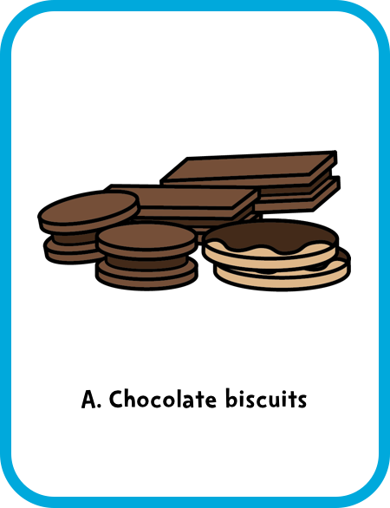
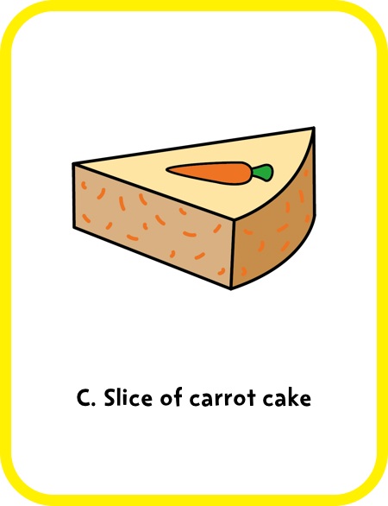
Notes:
Answer: B. Carrot sticks with lower-fat dip.
Fruit and veg are a great choice for snacks. You can try veg with a lower-fat dip. Chocolate biscuits and carrot cake can contain lots of added sugar and saturated fat so we shouldn’t eat them often.
Encourage audience participation. After a pupil reads out the question/answer options, they could choose a volunteer to answer, ask for a show of hands, or audience members could hold up A, B or C cards according to their guess.
Remember that fresh fruit and vegetables, plain milks and plain natural yoghurts all contain ‘intrinsic sugars’, which we don’t need to worry about. 5 A Day guidance specifies that dried fruit and fruit juice, vegetable juice and smoothies are not suitable to be consumed between meals due to dental concerns.
For more information, see the EatWell guide: https://campaignresources.phe.gov.uk/schools/resources/eatwell-guide

Slide 8
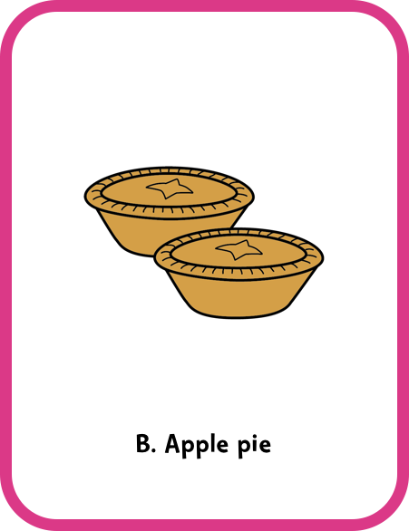
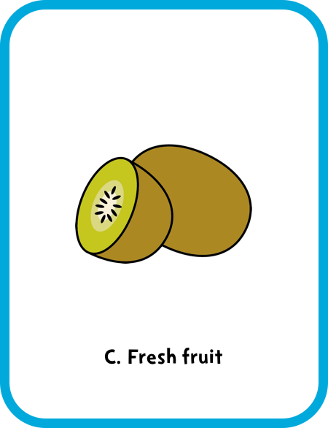
Notes:
Answer: C. Fresh fruit.
Fresh fruit and vegetables, plain milks and plain natural yoghurts all contain ‘intrinsic sugars’, which we don’t need to worry about. But ice cream and apple pie can contain lots of added sugar so we shouldn’t eat them often.
Encourage audience participation. After a pupil reads out the question/answer options, they could choose a volunteer to answer, ask for a show of hands, or audience members could hold up A, B or C cards according to their guess.
5 A Day guidance specifies that dried fruit and fruit juice, vegetable juice and smoothies are not suitable to be consumed between meals due to dental concerns. For more information, see the EatWell guide: https://campaignresources.phe.gov.uk/schools/resources/eatwell-guide

Slide 10
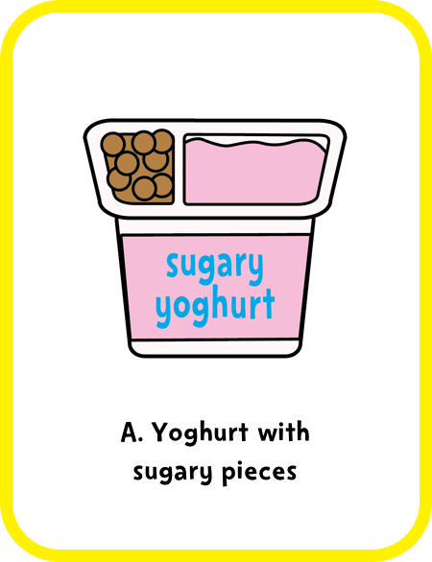
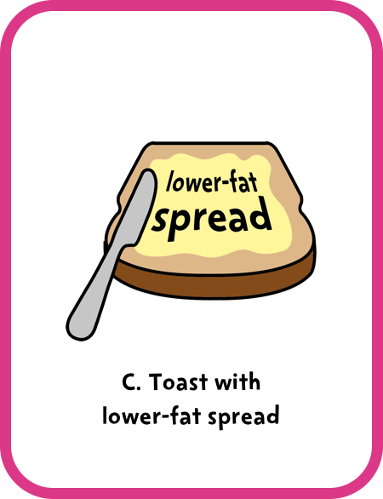
Notes:
Answer: C. Toast with lower-fat spread.
Sugary yoghurt and pastries can contain lots of added sugar and saturated fat so we shouldn’t eat them often. Fruit and veg are a great choice for snacks.
Encourage audience participation. After a pupil reads out the question/answer options, they could choose a volunteer to answer, ask for a show of hands, or audience members could hold up A, B or C cards according to their guess.
Remember that fresh fruit and vegetables, plain milks and plain natural yoghurts all contain ‘intrinsic sugars’, which we don’t need to worry about. 5 A Day guidance specifies that dried fruit and fruit juice, vegetable juice and smoothies are not suitable to be consumed between meals due to dental concerns.
For more information, see the EatWell guide: https://campaignresources.phe.gov.uk/schools/resources/eatwell-guide

Slide 12
Notes:
Extension: if your pupils have created an ‘advert’, this could be a good time to show/perform it.

Slide 13
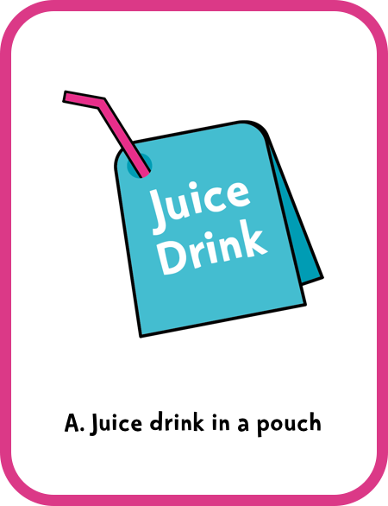
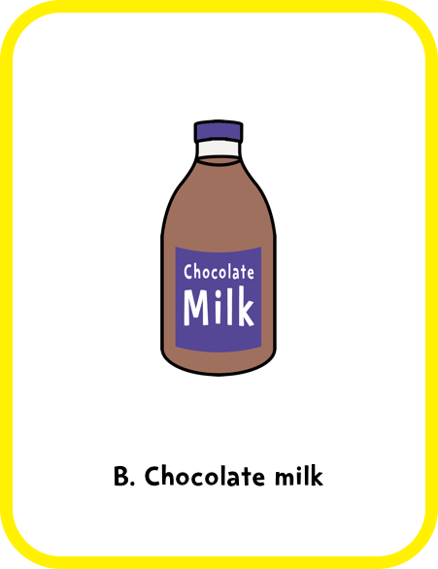
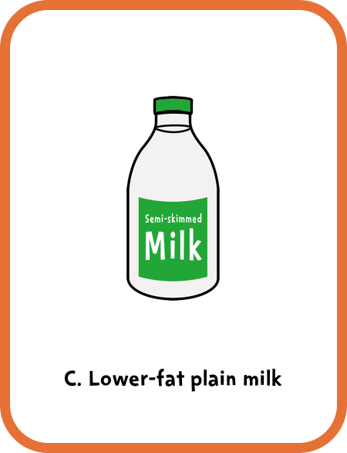
Notes:
Answer: C. Lower-fat plain milk.
Juice drinks in a pouch and flavoured milks can contain lots of added sugar so we shouldn't drink them often. Lower-fat milks or plain water are always the best drink choices.
Encourage audience participation. After a pupil reads out the question/answer options, they could choose a volunteer to answer, ask for a show of hands, or audience members could hold up A, B or C cards according to their guess.
Remember that fresh fruit and vegetables, plain milks and plain natural yoghurts all contain ‘intrinsic sugars’, which we don’t need to worry about. 5 A Day guidance specifies that dried fruit and fruit juice, vegetable juice and smoothies are not suitable to be consumed between meals due to dental concerns.
For more information, see the EatWell guide: https://campaignresources.phe.gov.uk/schools/resources/eatwell-guide

Slide 15
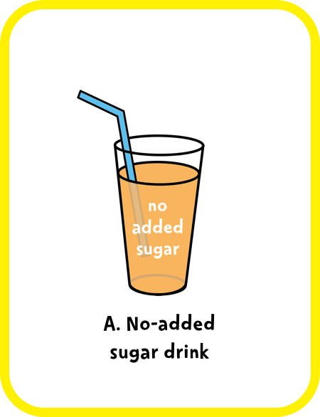
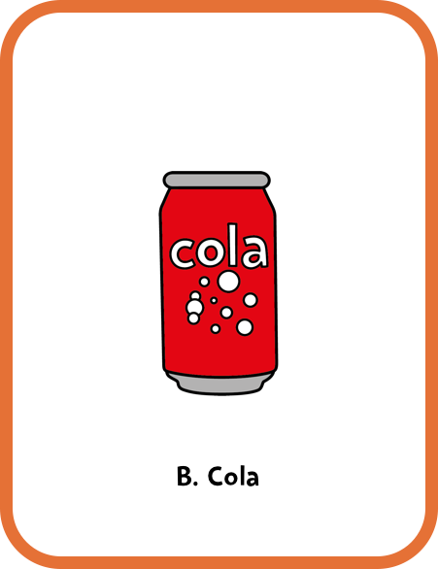
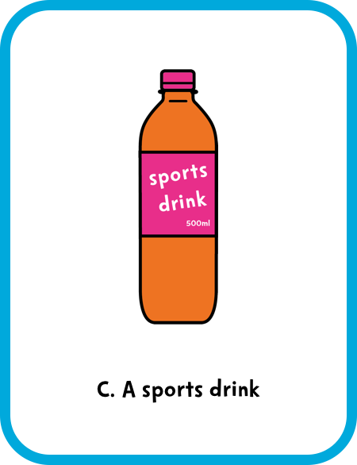
Notes:
Answer: A. No-added sugar drink.
Cola and sports drinks can contain lots of added sugar so we shouldn't drink them often. Some manufacturers create no-added sugar drinks, which are a better choice than sugary or sports drinks. Lower-fat milks or plain water are always the best drink choices.
Encourage audience participation. After a pupil reads out the question/answer options, they could choose a volunteer to answer, ask for a show of hands, or audience members could hold up A, B or C cards according to their guess.
Remember that fresh fruit and vegetables, plain milks and plain natural yoghurts all contain ‘intrinsic sugars’, which we don’t need to worry about. 5 A Day guidance specifies that dried fruit and fruit juice, vegetable juice and smoothies are not suitable to be consumed between meals due to dental concerns.
For more information, see the EatWell guide: https://campaignresources.phe.gov.uk/schools/resources/eatwell-guide

Slide 17
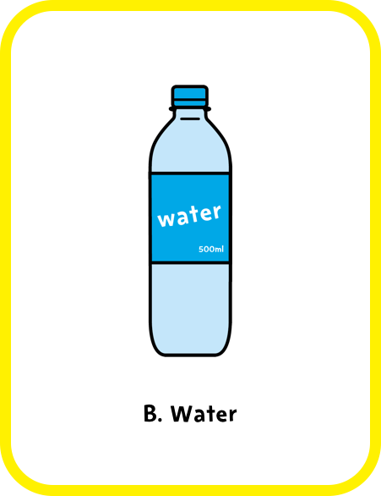
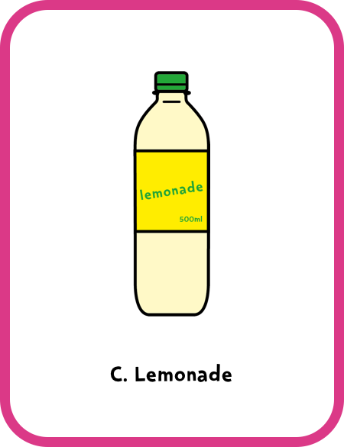
Notes:
Answer: B. Water.
Juice drinks in a pouch and lemonade can contain lots of added sugar so we shouldn't drink them often. Some manufacturers create no-added sugar drinks, which are a better choice than sugary or sports drinks. Lower-fat milks or plain water are always the best drink choices.
Encourage audience participation. After a pupil reads out the question/answer options, they could choose a volunteer to answer, ask for a show of hands, or audience members could hold up A, B or C cards according to their guess.
Remember that fresh fruit and vegetables, plain milks and plain natural yoghurts all contain ‘intrinsic sugars’, which we don’t need to worry about. 5 A Day guidance specifies that dried fruit and fruit juice, vegetable juice and smoothies are not suitable to be consumed between meals due to dental concerns.
For more information, see the EatWell guide: https://campaignresources.phe.gov.uk/schools/resources/eatwell-guide

Slide 19
Notes:
This reinforces the key message.
Pupils could include a demonstration for the audience of the amount of sugar in two bottled drinks using the Food Scanner app.

Slide 20
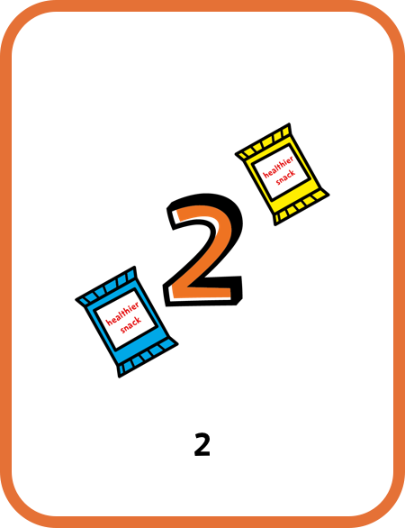
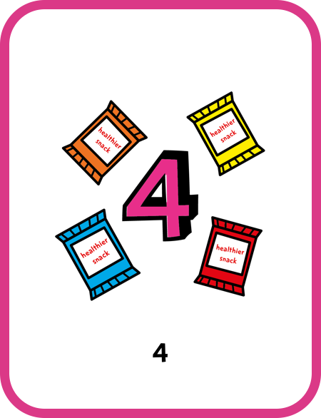
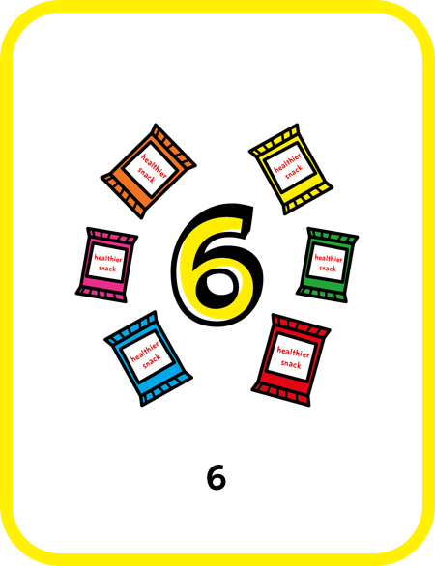
Notes:
Answer: A. 2.
Fruit and veg are a great choice for snacks. If you do have a packaged snack, try to have no more than two per day.
Encourage audience participation. After a pupil reads out the question/answer options, they could choose a volunteer to answer or ask for a show of hands.

Slide 22
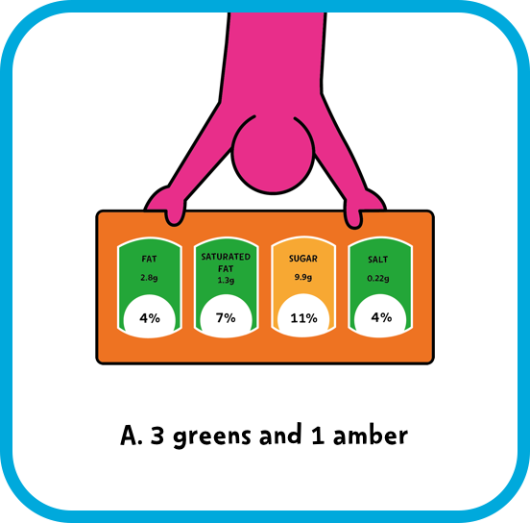
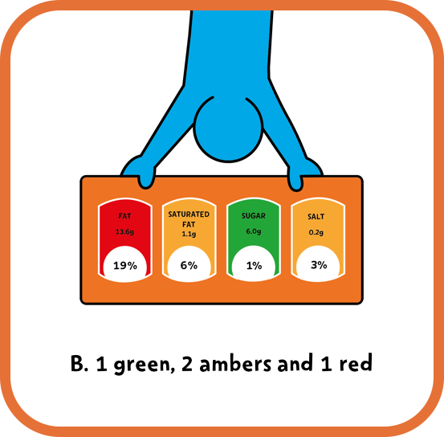
Notes:
Answer: A. 3 greens and 1 amber.
Look for mostly green, or greens and ambers on the label. Cut down on reds!
Encourage audience participation. After a pupil reads out the question/answer options, they could choose a volunteer to answer, ask for a show of hands, or audience members could hold up the A or B card according to their guess.

Slide 24
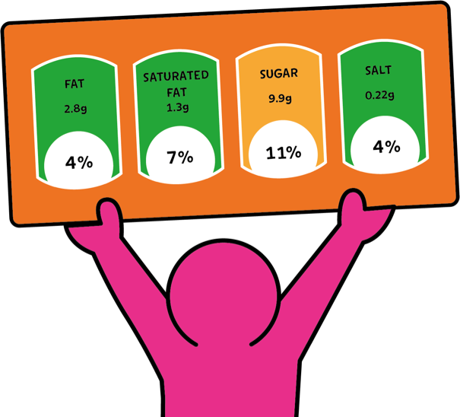
Notes:
This reinforces the key message. You (or your pupils) could ask the audience to remember what colour they should avoid on packaged snacks, and what the maximum number of packaged snacks they should have in a day is.
Pupils could show the audience examples of snacks that have mostly greens and snacks that have reds on the label.

Slide 26
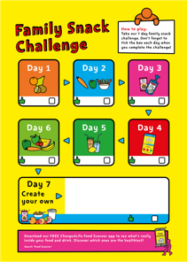
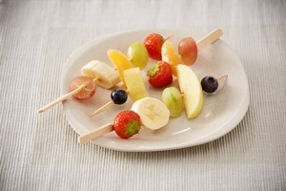
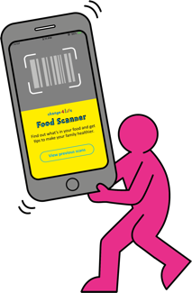
Notes:
If your class has prepared ideas for Day 7 of the Family Snack Challenge, they can present them now. They can ask the audience to vote on their favourite challenge idea (let parents and carers vote too!).
Don’t forget to tell parents and carers to search Change4Life for more fun snack recipes and ideas.

